Slide 1
btctrackr : Finding and Displaying Clusters in Bitcoin
Aaron Doll, Shaheed Chagani,
Michael Kranch, and Vaidhyanath Murti

Slide 2
Overview
Motivation (Fistful of Bitcoins)
Challenges and Goals
btctrackr System
Parser
Database
Website
Demonstration
Evaluation
Future Work

Slide 3
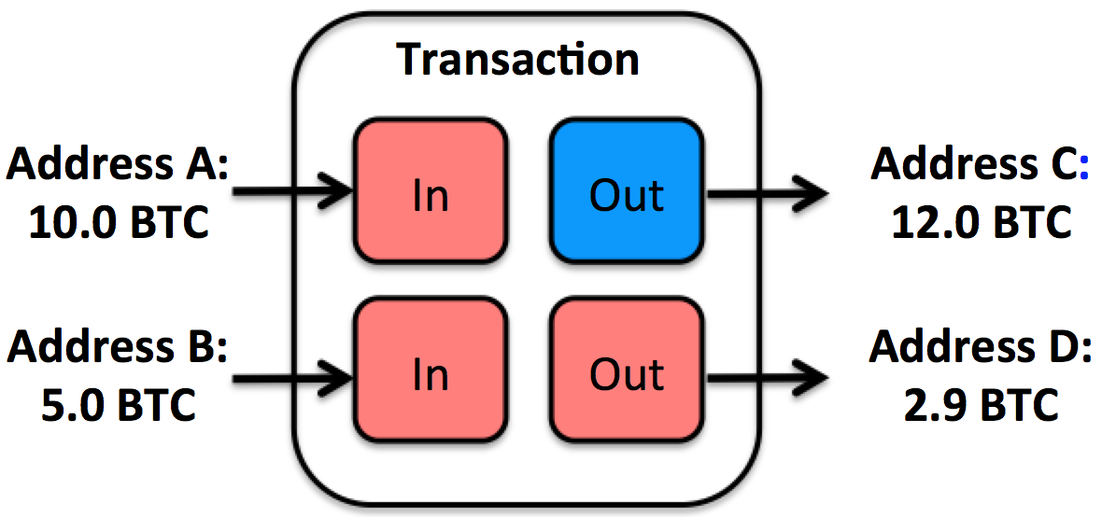
Motivation (Fistful of Bitcoins)
Improve upon Existing Address Clustering
Heuristic 1 – All inputs
Heuristic 2 – Change Addresses
Current Implementation
Need significant by hand cleaning
Not in real-time
Znort Parser

Slide 4
Goals / Challenges
Challenges
Resource management
Continually updating information
Legacy block chain information
Integration of systems
System Goals
Real-time responses
Accurate
Expandable

Slide 5
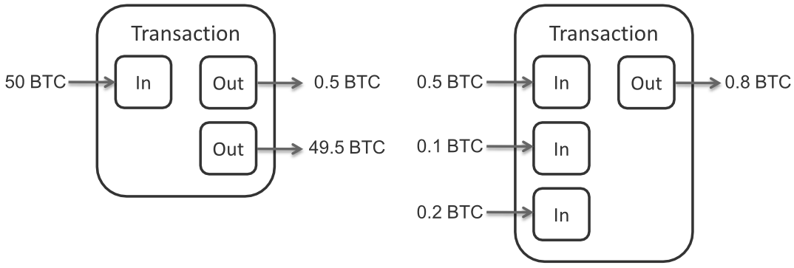
btctrackr: Parser
Libbitcoin
Three Steps
Find clustering transactions
Find input addresses of transaction
Keep track of connected components

Slide 6




btctrackr: Database
BTC Network
Website
Downloader
Updater
Parser
LevelDB
MySQL
Blockchain
Address to Cluster ID Map

Slide 7
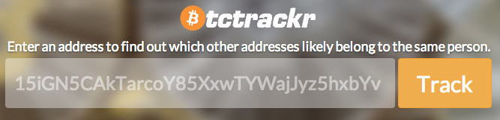
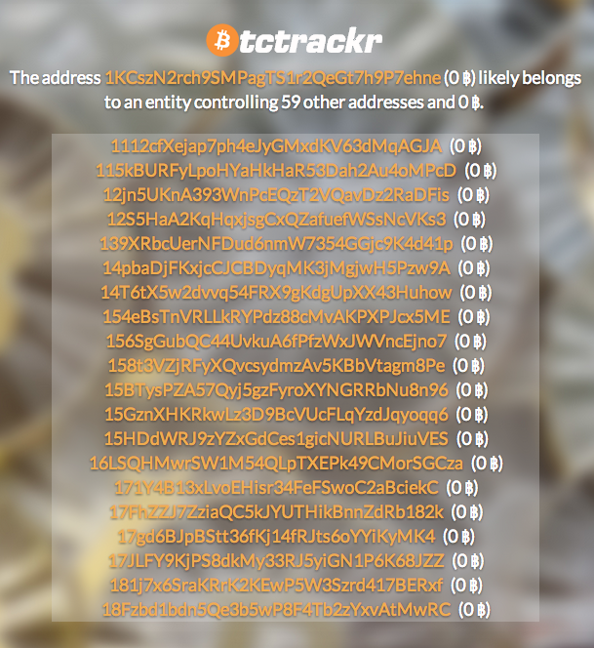
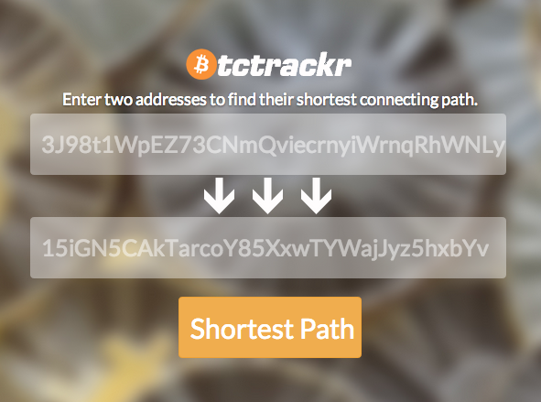
btctracker - Website
Track
Cluster Balances
Shortest Path

Slide 8
DEMO

Slide 9
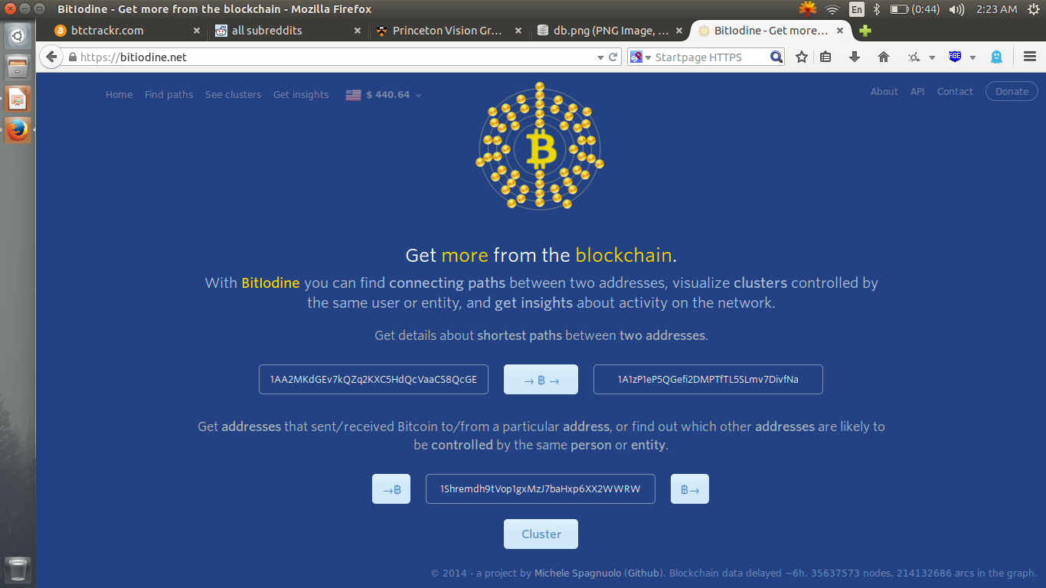
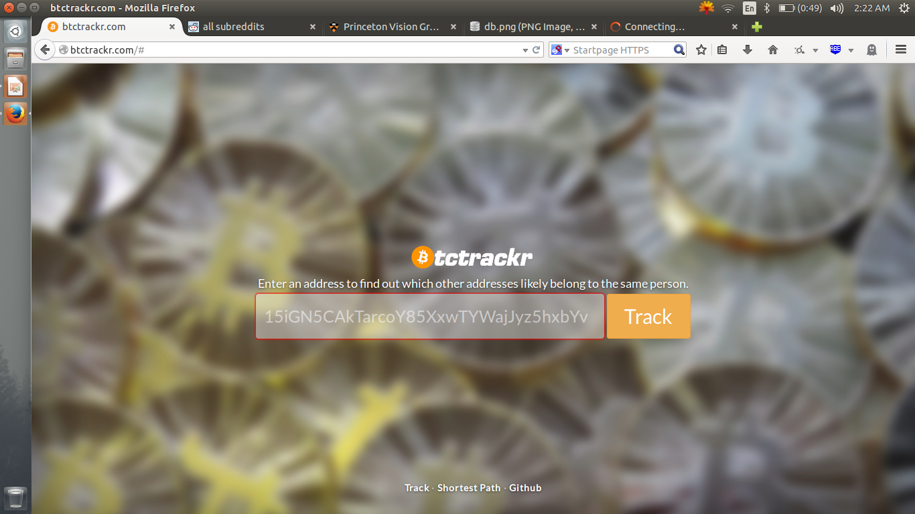
Evaluation
VS
 | False Negative %
btctrackr* | 35.8
BitIodine | 54.2
at the time of this evaluation btctrackr
only had 200,000 blocks parsed

Slide 10
Future Work
Increased speed for balances
Increased accuracy for 1-hop paths
Cluster labeling
Advanced Features:
Implementation of the change heuristic
Labeling and Identifying well-known cluster
Tracking IP addresses

